Slide 1




IAIN World
Congress 2024
Krakow, POland
Notes:
Thank you very much for the opportunity to present our proposition. I promise that I don’t take care of a lot of time.
Referring to my speech at the GA in Prague,
I want like to show that Polish Navigation Forum is really seriously interested in organizing IAIN World Congress in 2024 in Poland.

Slide 2



KRAKÓW
Notes:
We propose that the Congress was held in very special for Central European city in Krakow. Krakow is located in the south of Poland. Krakow is the former capital city, the historic seat of Polish Kings.

Slide 3
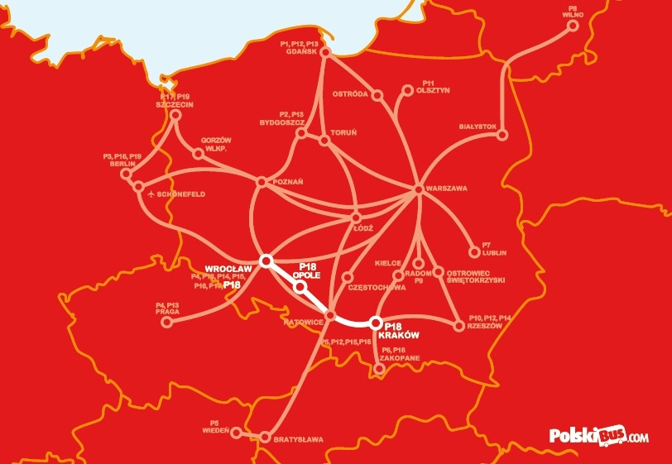




KALININGRAD
992 HOTELS
17 Airlines give directly connection
17 km West of Kraków
3,5 mln passengers annually
10 hotels
32 hotels
81 hotels
7 hotels
1 hotel
858 hotels,guesthouse
MINSK
with out stars
About Krakov
800 ,000 inhabitatnts
8,000,000 visitors annually
above 100 restaurants with
cuisines from around the world
LWOW
High Schools
IT Sector
24 Universities
1,800 professors
210,000 students
ONET
INTERIA
COMARCH SA
Notes:
Krakow has a very good road connection (thanks to the motorways and the express ways) with all countries around the Poland. Moreover Krakow Airport has direct flights to 17 European capitals and via Warsaw connect with all over the world. In Krakow, we have a network of about 1,000 hotels and hostels.
Krakow is home for about 800,000 inhabitatnts.
There are 24 universities and high schools. Krakow is home to major companies in the IT sector in Poland. 3 largest you can find on the slide.

Slide 4

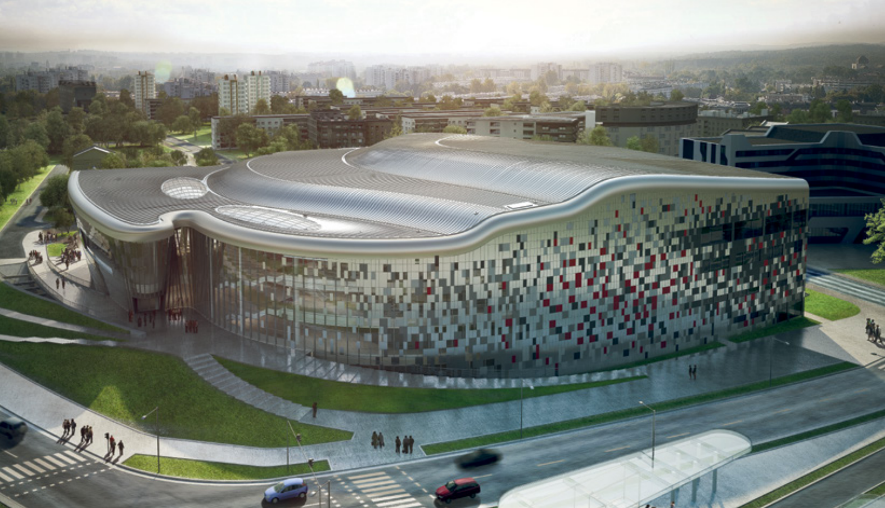
Congress Venue
International Congress Centre
Notes:
We found about 30 conference centers (different standard, different number of participants), but for our Congress we choice two.
The first is the newest and one of bigger place: International Congress Centre which was completed in 2014.

Slide 5
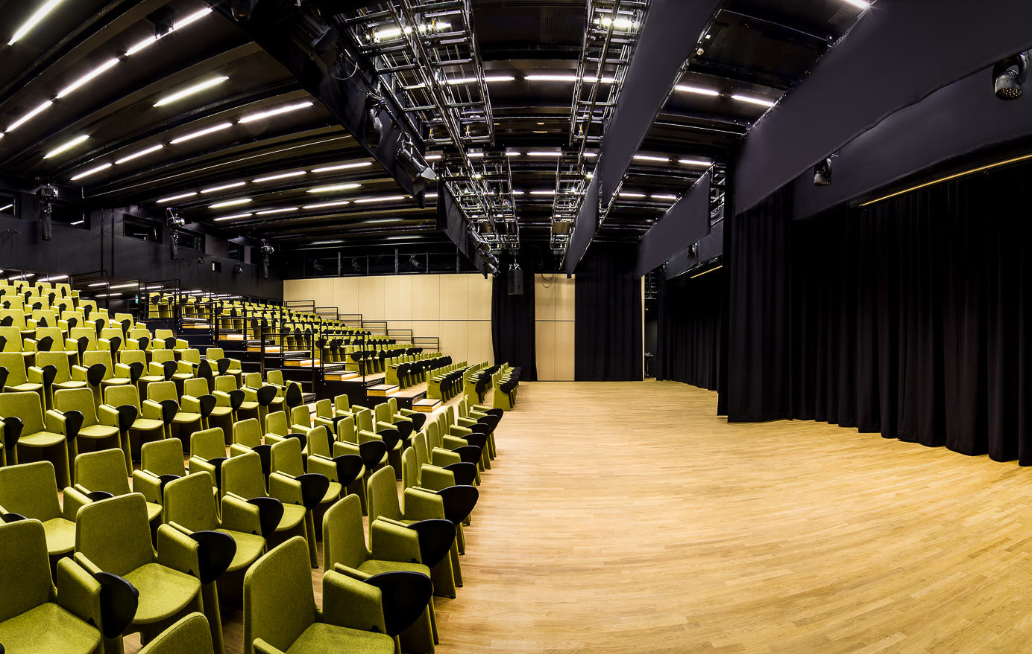
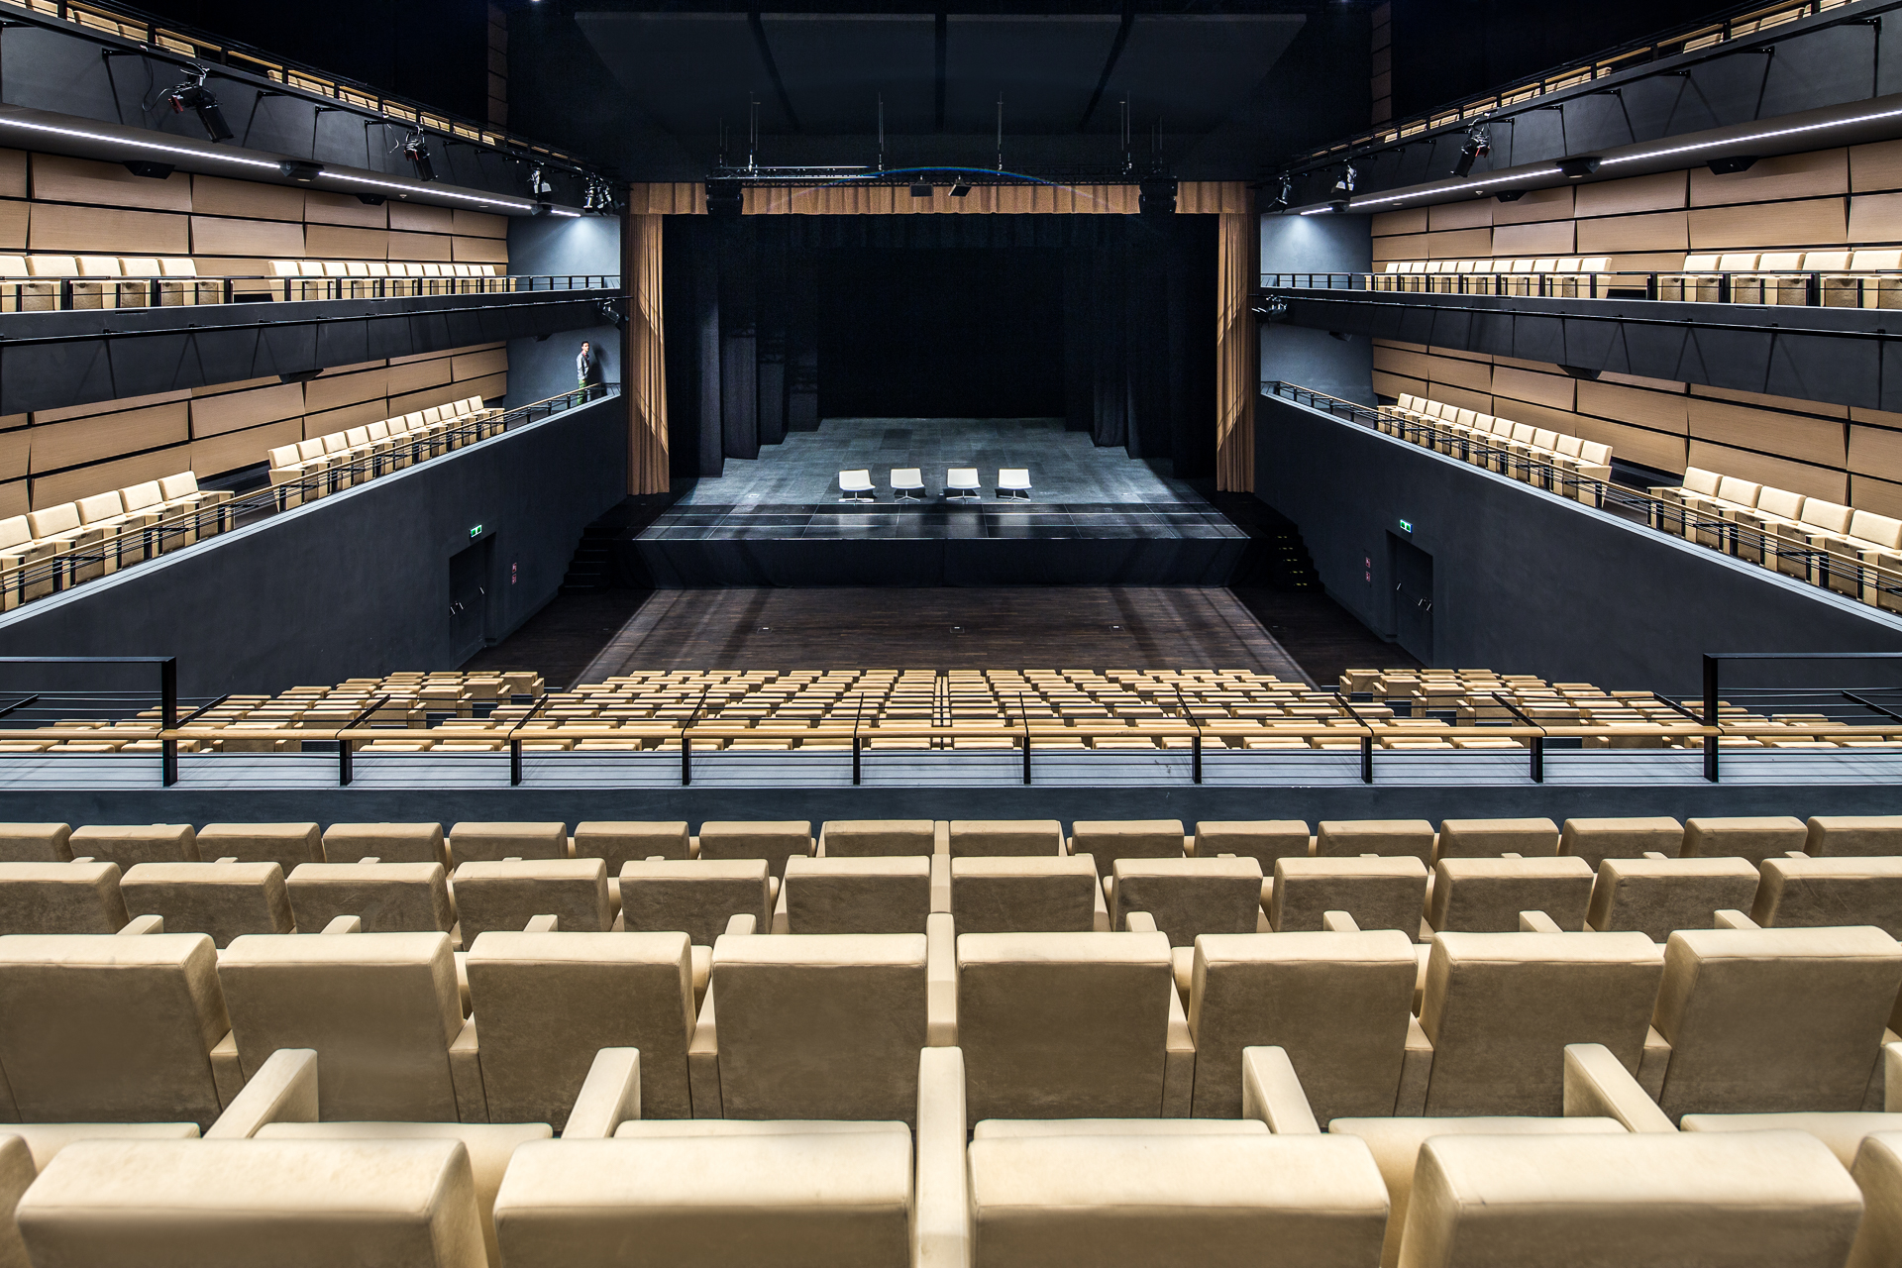
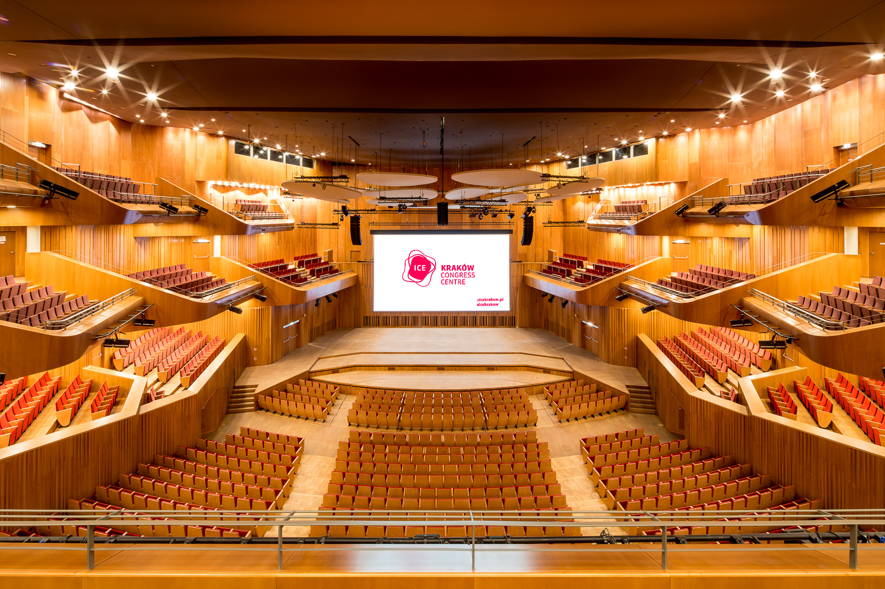
Conference Halls
Notes:
Here we have a lot of conference rooms, which can be adapted according to our needs.

Slide 6
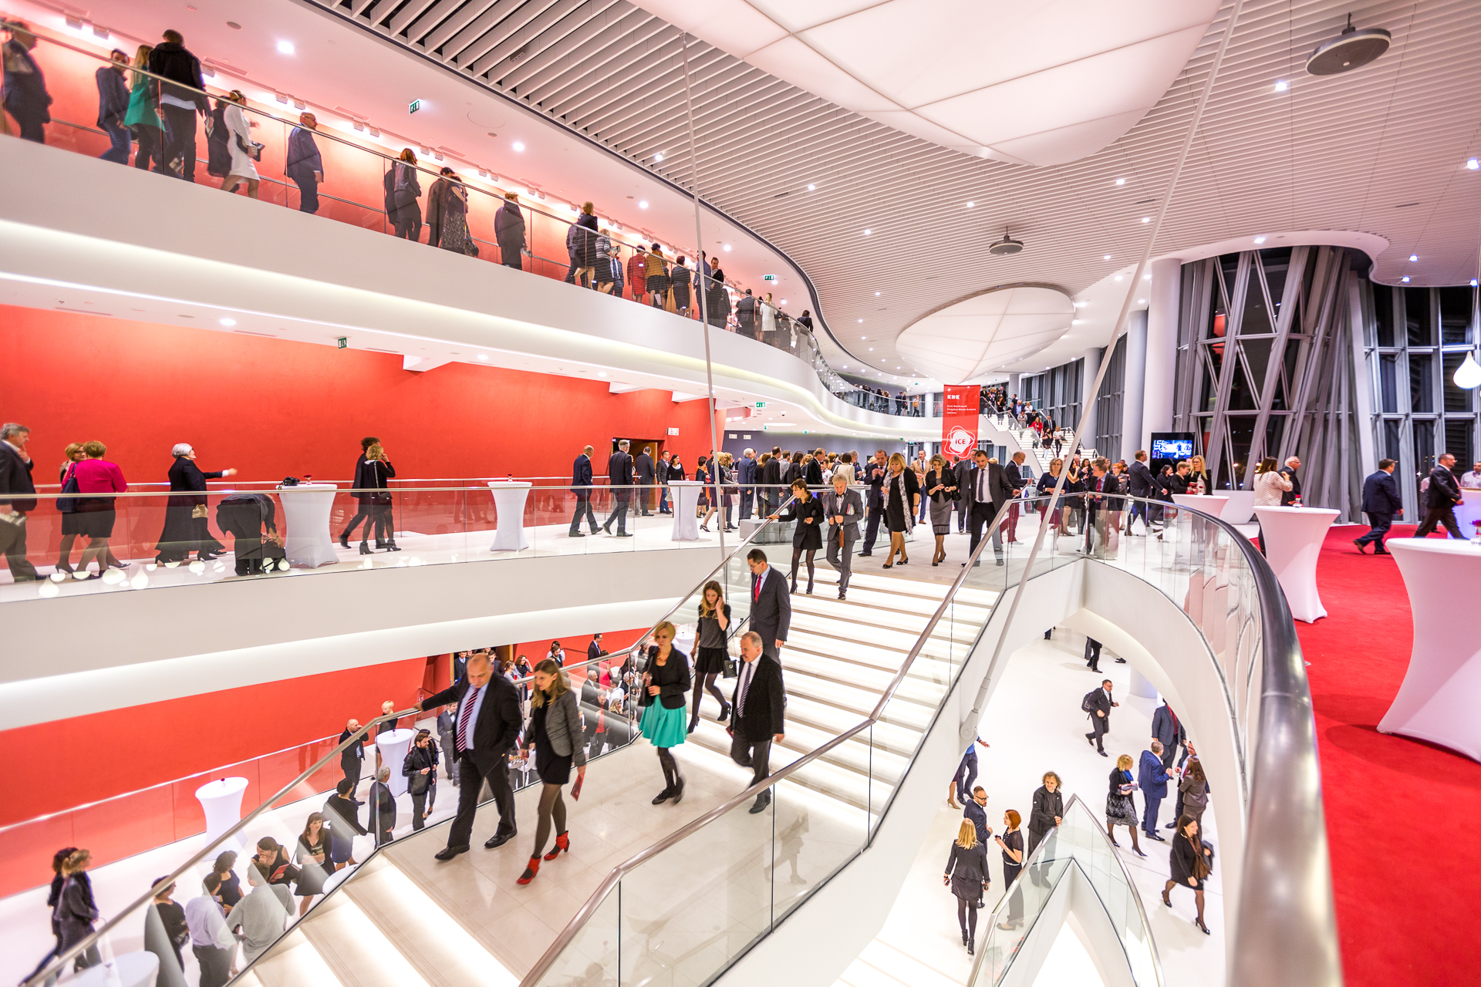
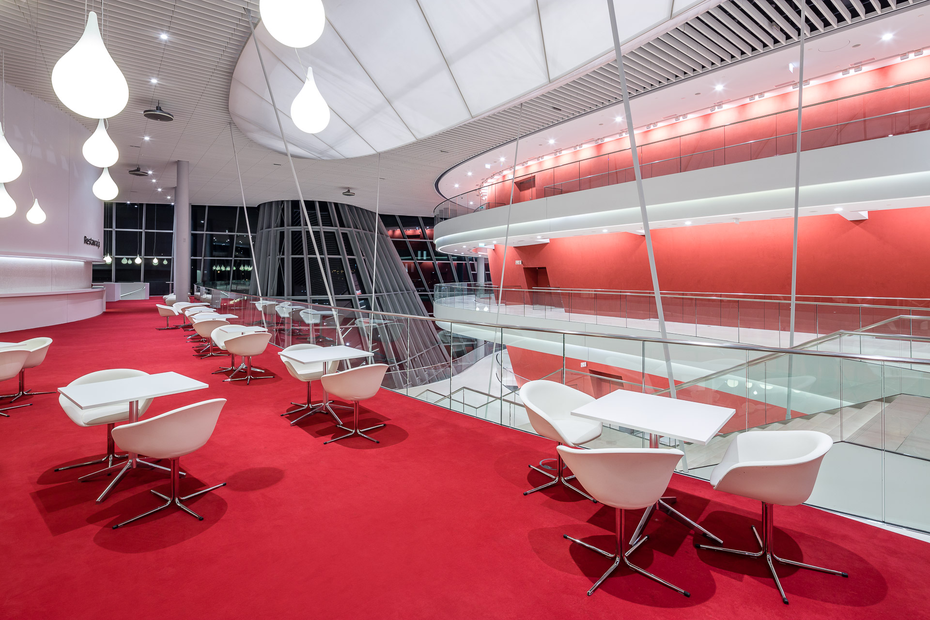
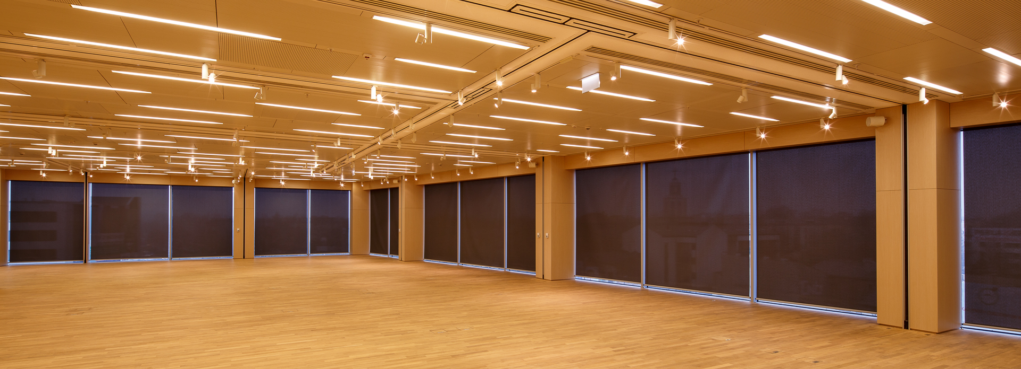
Conference Halls
Notes:
Fouye will give us space for serving meals. There is also a space for exhibitions.

Slide 7

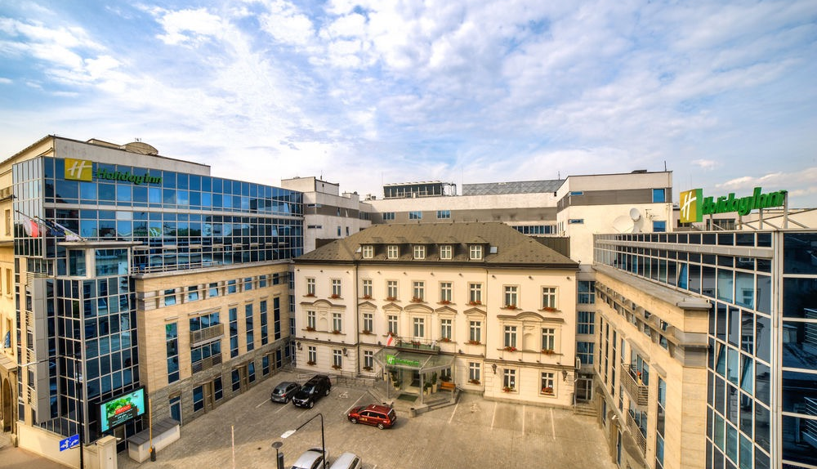
Holiday Inn
Conference CENTrE
Notes:
If the analysis of the costs and our needs that this place is too large for us.
We have second proposal: the conference center at the Holiday Inn

Slide 8
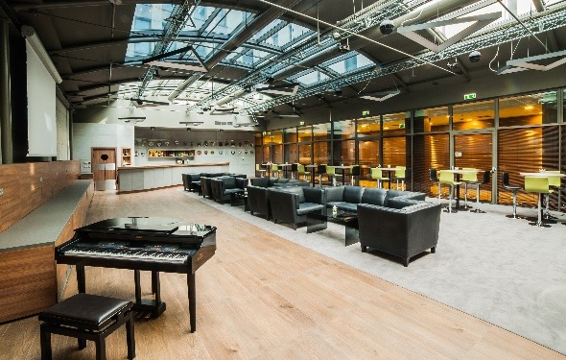
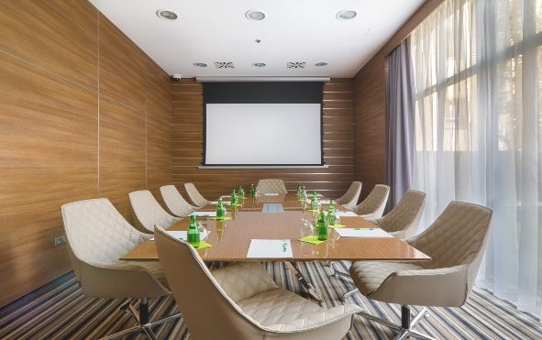
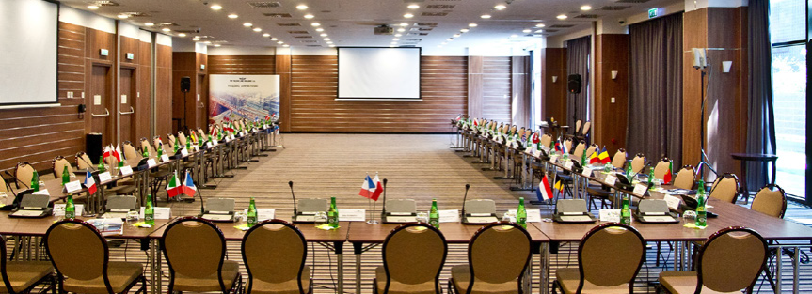
Conference Halls
Notes:
Here, we have too a sufficient number of conference rooms adapted to the needs of users.

Slide 9
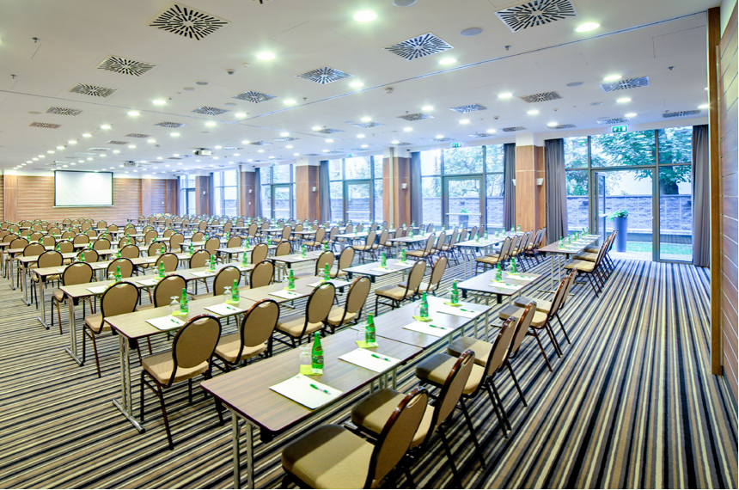
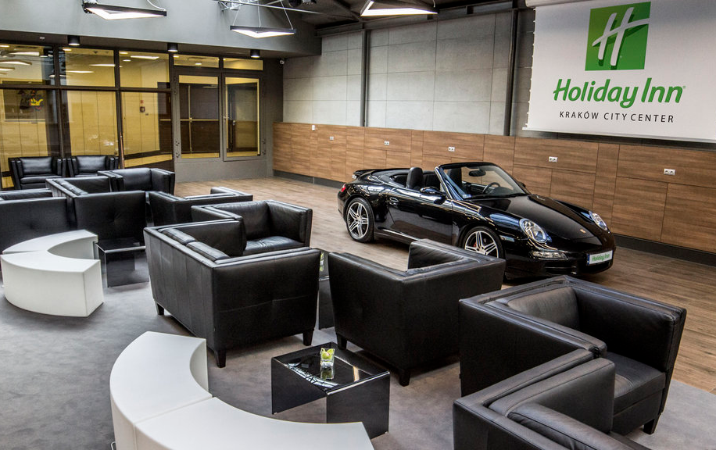
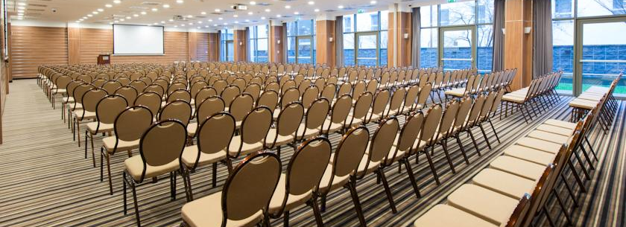
Conference Halls
Notes:
Exhibit space is so large that allows to organize presentations of new car models. Moreover, this place has suitable number of rooms for participants of congress.

Slide 10
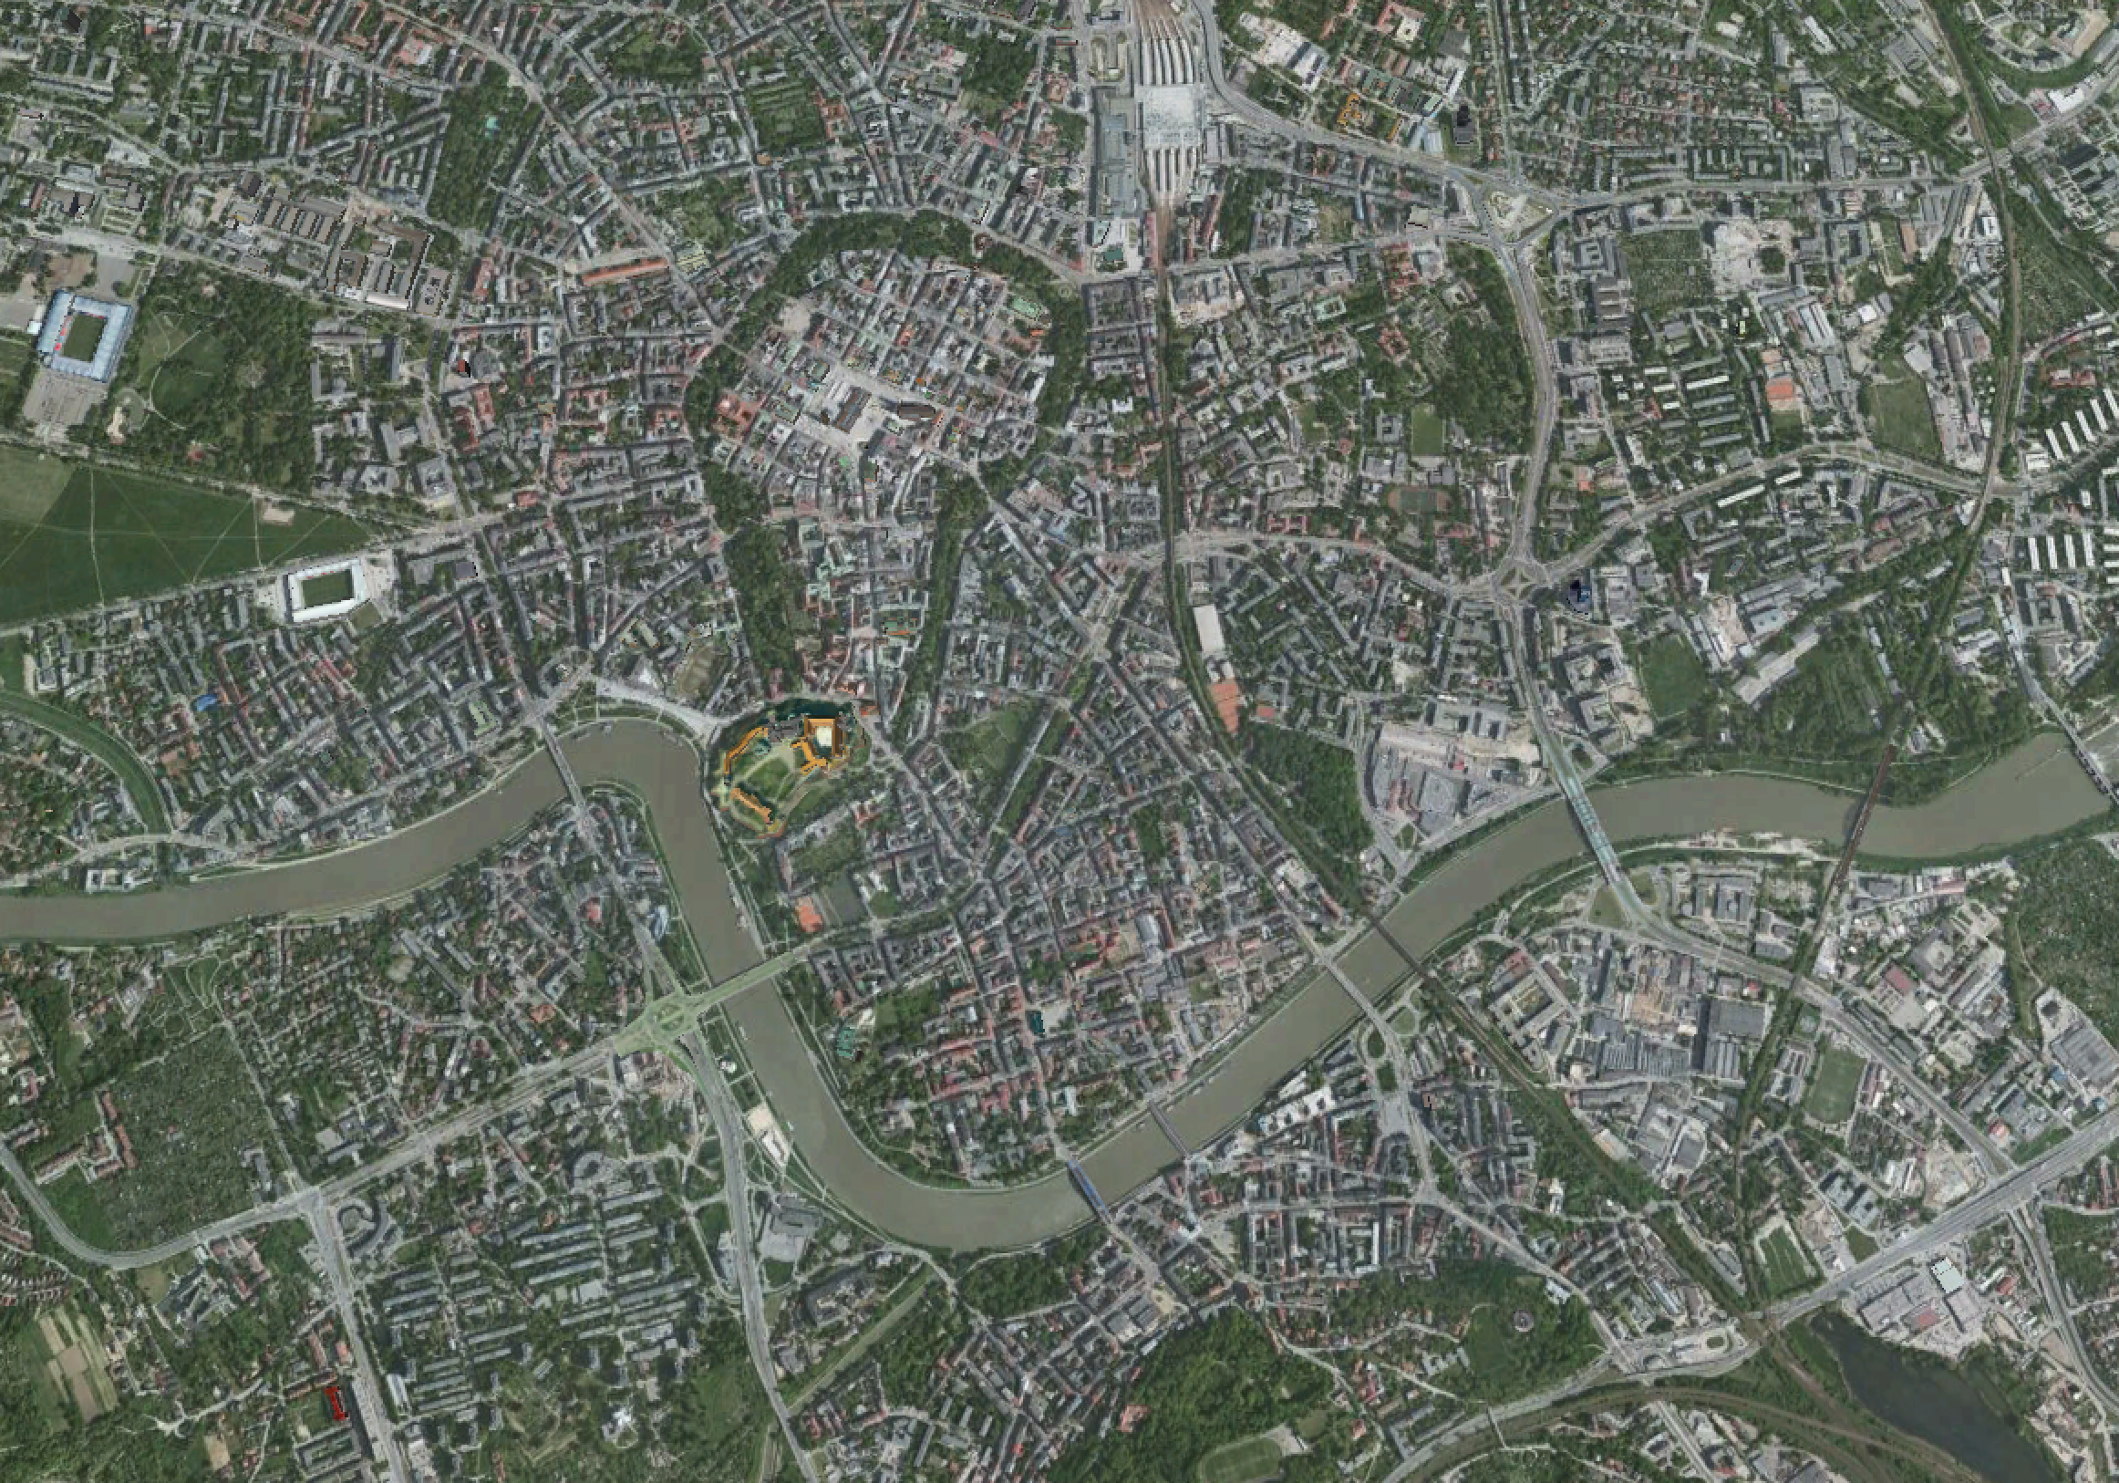
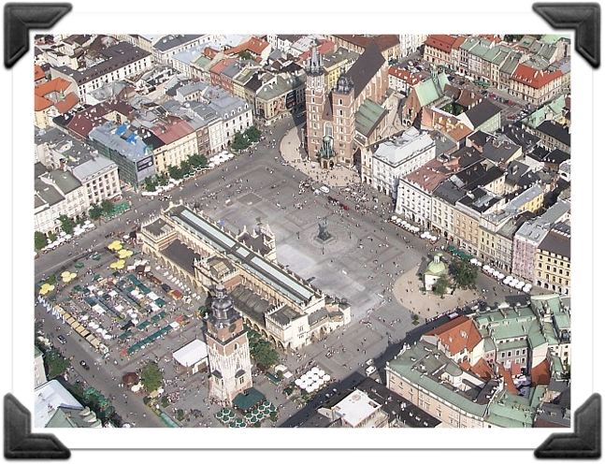
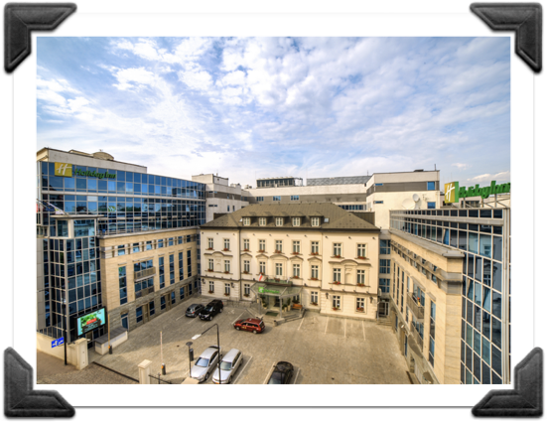
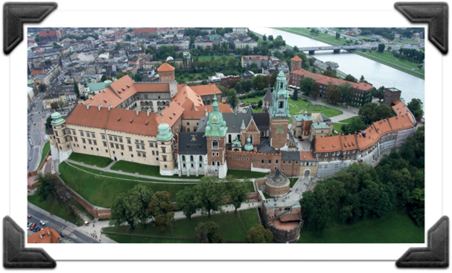
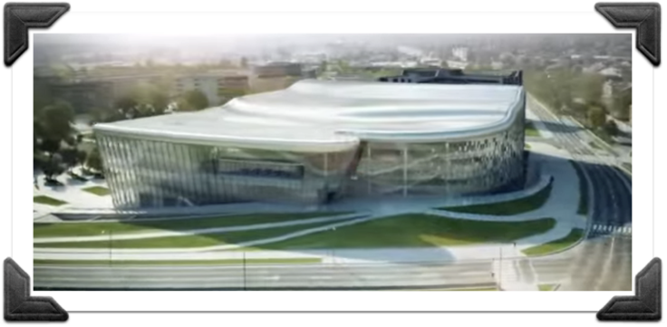
KRAKÓW
Vistula
Vistula
Notes:
On the next slide we can see the location of the proposed center in relation to the Royal Castle and the Old Town Square.

Slide 11
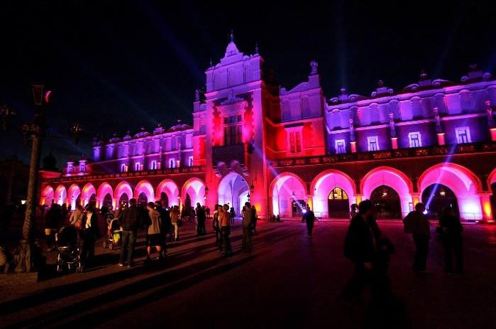
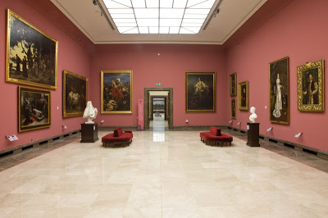
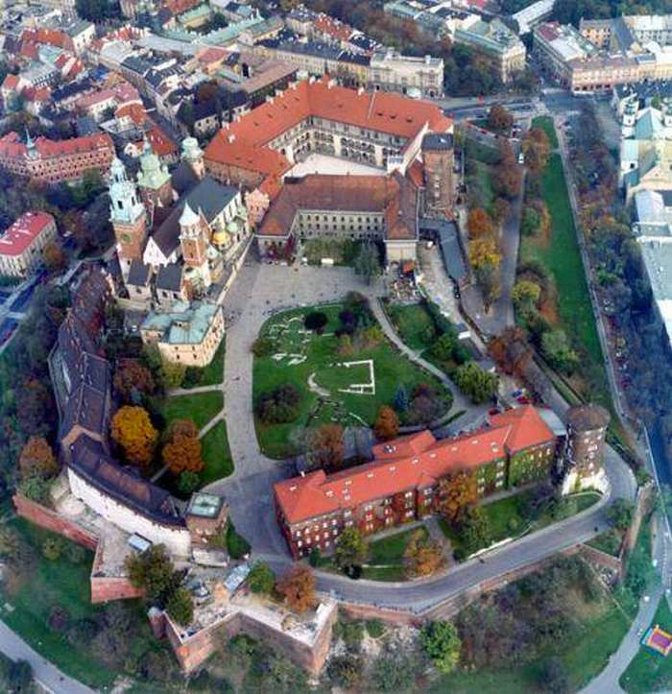
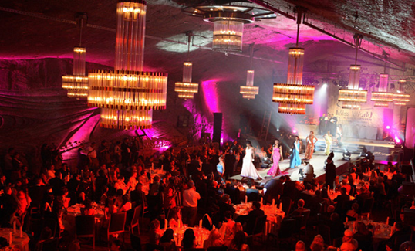
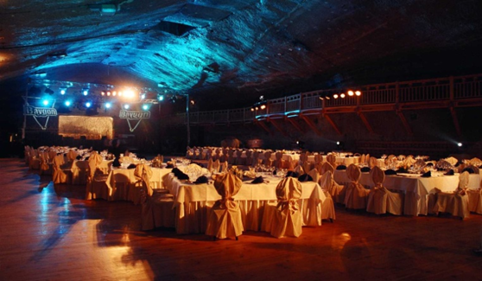
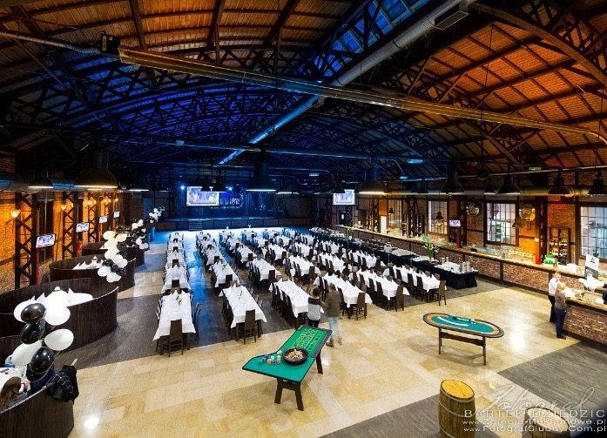
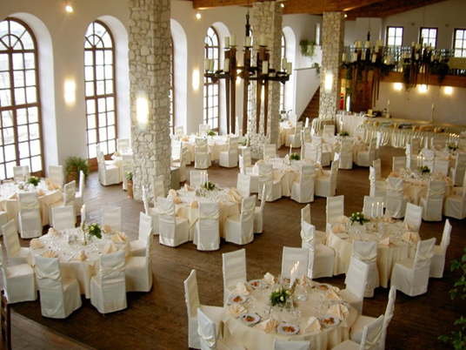

Social Venues
THE CLOTH HALL
WAWEL - the RESIDENCE of POLISH KINGS
WIELICZKA SALT MINE
OTHER VENUES
Notes:
I think that we can organize one social venue in the cloth hall on the Old Town Square and the second venue could be on Wawel or in a salt mine in Wieliczka.
If number of participants will be not enough we have many other suitable places

Slide 12
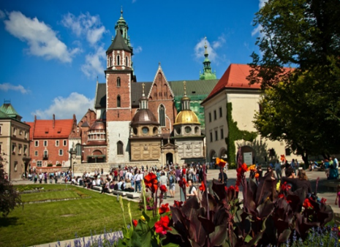
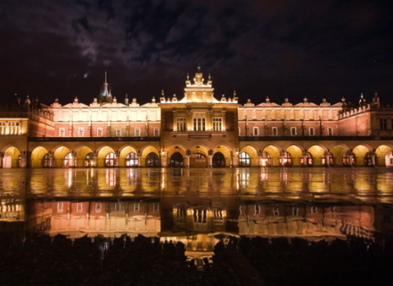
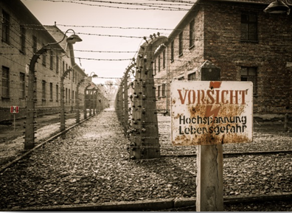

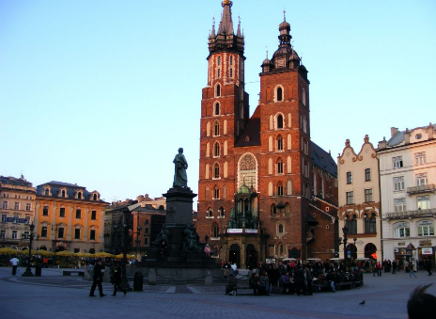
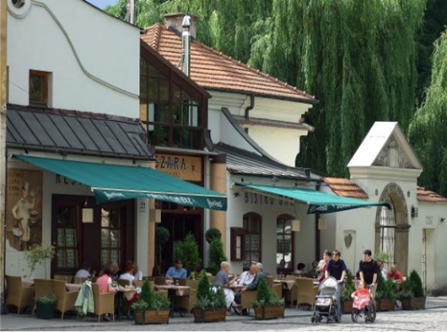
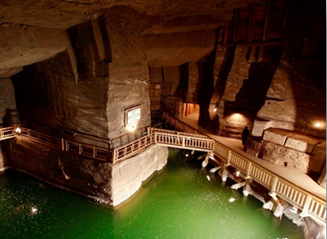
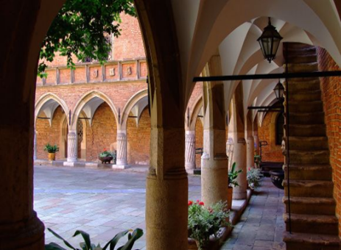
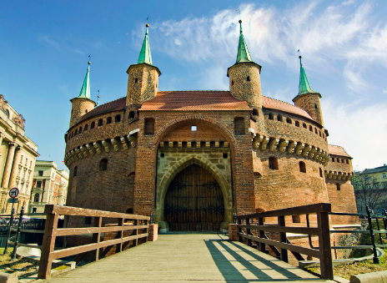
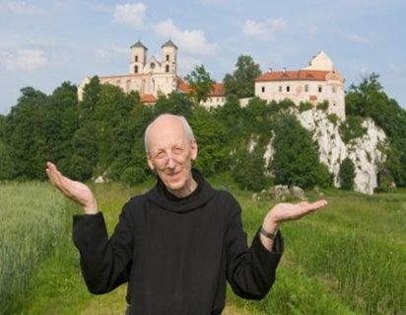
Top Attractions
KRAKÓW
NEARBY KRAKÓW
Wawel Castle
the residence of Polish Kings build in 14th century,
crown jewel of Kraków’s architecture
Cloth Hall, Sukiennice
place that used to be the centre of Polish international trade
during the „golden ages”
Auschwitz-Birkenau
biggest, former Nazi death camp,
symbol of terror, genocide and the Holocaust
Saint Mary’s Basilica
iconic symbol of Main Square,
place where you can here “the famous trumpeter”
Kazimierz District
centre of Jewish life in Kraków for over 5 centuries,
arguably city’s most exiting district
Wieliczka Salt Mine
World Heritage Site, product of work of tens of
generations of miners throughout history
Collegium Maius
Oldest building of one of the first universities
in central Europe, Jagiellonian University
Tyniec Abbey
spectacular Benedictine abbey upon the riverbank,
12 km upstream from the Wawel Royal Castle
The Great Barbican of Krakow
Kraków’s main city gate,
late-medieval defense construction
Notes:
Each conference is not only the meeting but also learning about the history of countries and cities. I'm sure that Krakow as a 1000-years old city has much to offer:
- Castle on the Wawel hill
- old town square with the famous basilica of St. Mary's
- Collegium Marius - oldest building of the first university in central Europe and many other
In nearby Krakow is located:
- Museum Auschwitz-Birkenau
- salt mine in Wieliczka
- spectacular Benedictine abbey in Tyniec

Slide 13
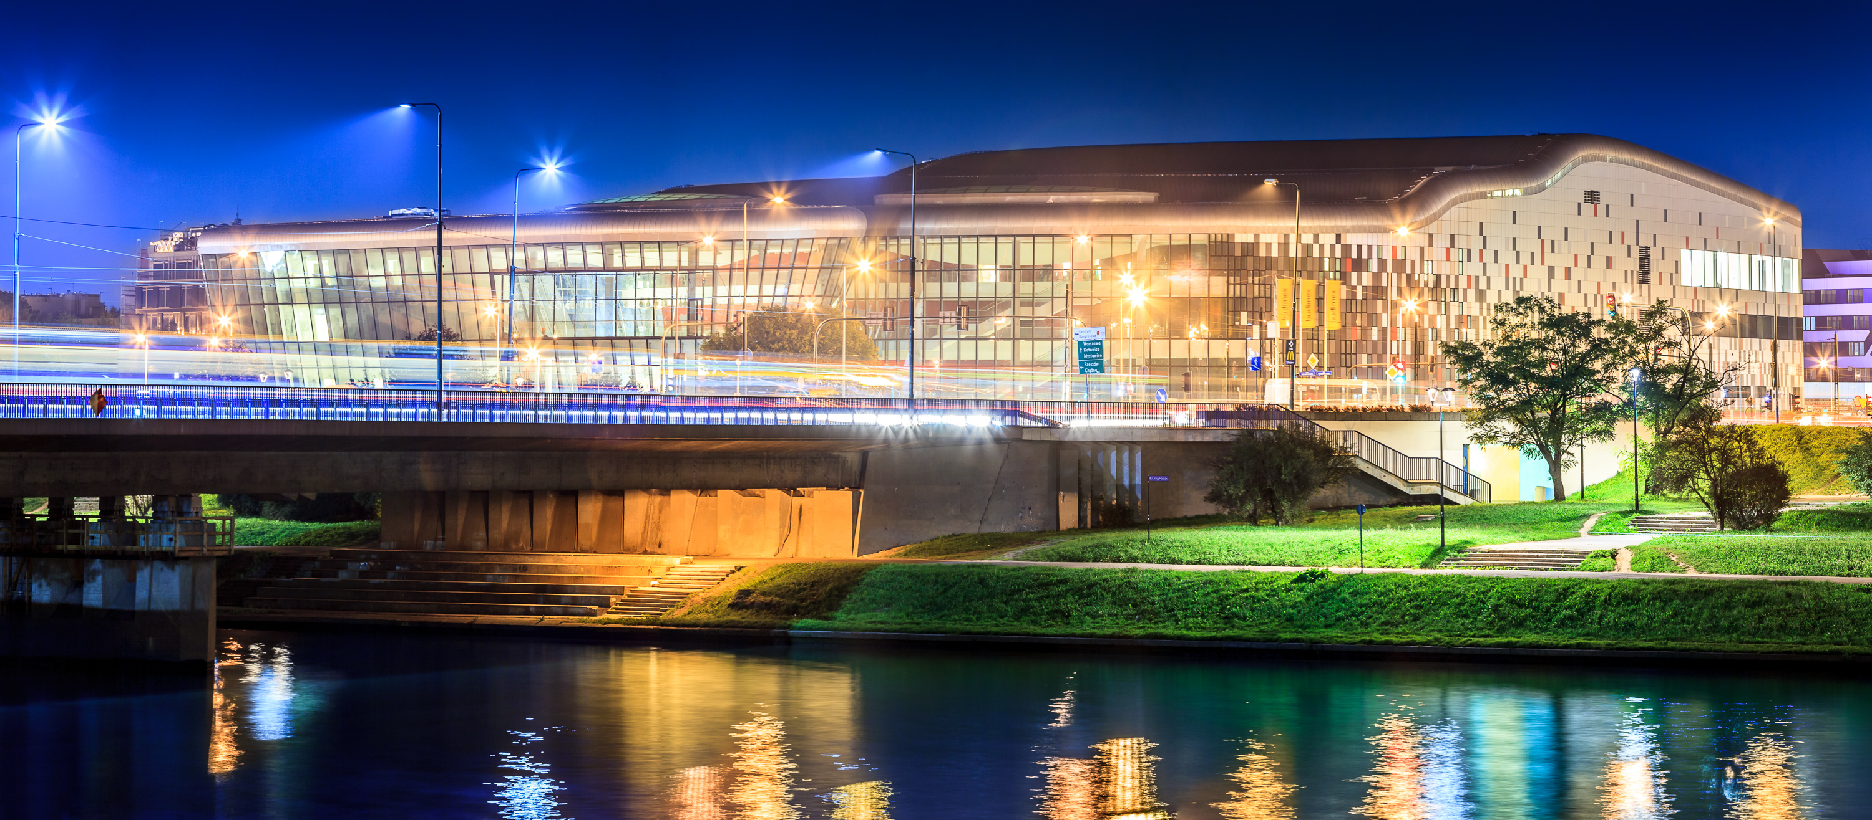

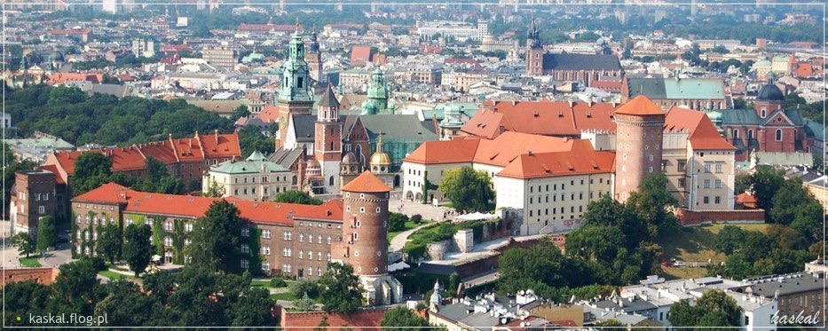
IAIN World Congress
Krakow 2024
friendly atmosphere
wonderful Congress Centre
millennial city
delicious food
an unforgettable impression only in Krakow
Notes:
I am sure that the Congress in Krakow will be characterized by:
- friendly atmosphere
- wonderful Congress Centre
- delicious food …. and all in millennial city

Slide 14
IAIN World
Congress 2024
Krakow, POland

